Slide 1
Discounting, Equity, Risk
Time
Ramsey rule
Declining discount rates
Space
Equity weights
Risk
Expectations
Certainty equivalents
Dismal theorem
All together now
How to choose ethical parameters

Slide 2
Lectures
Science
Scenarios & emission reduction options
Costs of emission reduction
Instruments for emission reduction
Impacts of climate change & adaptation
Economic impacts of climate change
Climate and development
Optimal emission reduction
Discounting, uncertainty, equity
International environmental agreements

Slide 3
Discounting, Equity, Risk
Time
Ramsey rule
Declining discount rates
Space
Equity weights
Risk
Expectations
Certainty equivalents
Dismal theorem
All together now
How to choose ethical parameters

Slide 4
Optimal emission reduction
Climate change is long-term, global, uncertain problem
If you do not care about the distant future, far-away lands, remote probabilities, you do not care about climate change

Slide 5
Optimal emission reduction
Climate change is long-term, global, uncertain problem
If you do not care about the distant future, far-away lands, remote probabilities, you do not care about climate change

Slide 6
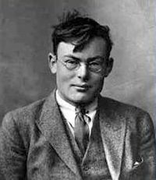

Time discounting
The Ramsey rule of discount
That is, we discount the future because
We will be richer and happier then
$$r=ρ+ηg$$

Slide 9

Time discounting
The Ramsey rule of discount
That is, we discount the future because
We will be richer and happier then
We are impatient
Note that the Ramsey rule describes the consumption side of intertemporal trade-offs – on the production side, there is the opportunity cost of capital
In a dynamic equilibrium, the two are equal
Discounting matters
$$r=ρ+ηg$$

Slide 10
No equity, no uncertainty

Slide 12
Time discounting
The Ramsey rule of discount
That is, we discount the future because
We will be richer and happier then
We are impatient
Impatience is controversial
On the one hand, we all are
Much evidence that people discount the future
On the other hand, we all know we should not be
Every religion, ethics argues for patience
$$r=ρ+ηg$$

Slide 13
Discounting, Equity, Risk
Time
Ramsey rule
Declining discount rates
Space
Equity weights
Risk
Expectations
Certainty equivalents
Dismal theorem
All together now
How to choose ethical parameters

Slide 14
Declining discount rates
Discounting should
Reflect the will of the people
Not ignore the far future
Be consistently applied accross public policy
Can this be done?

Slide 15
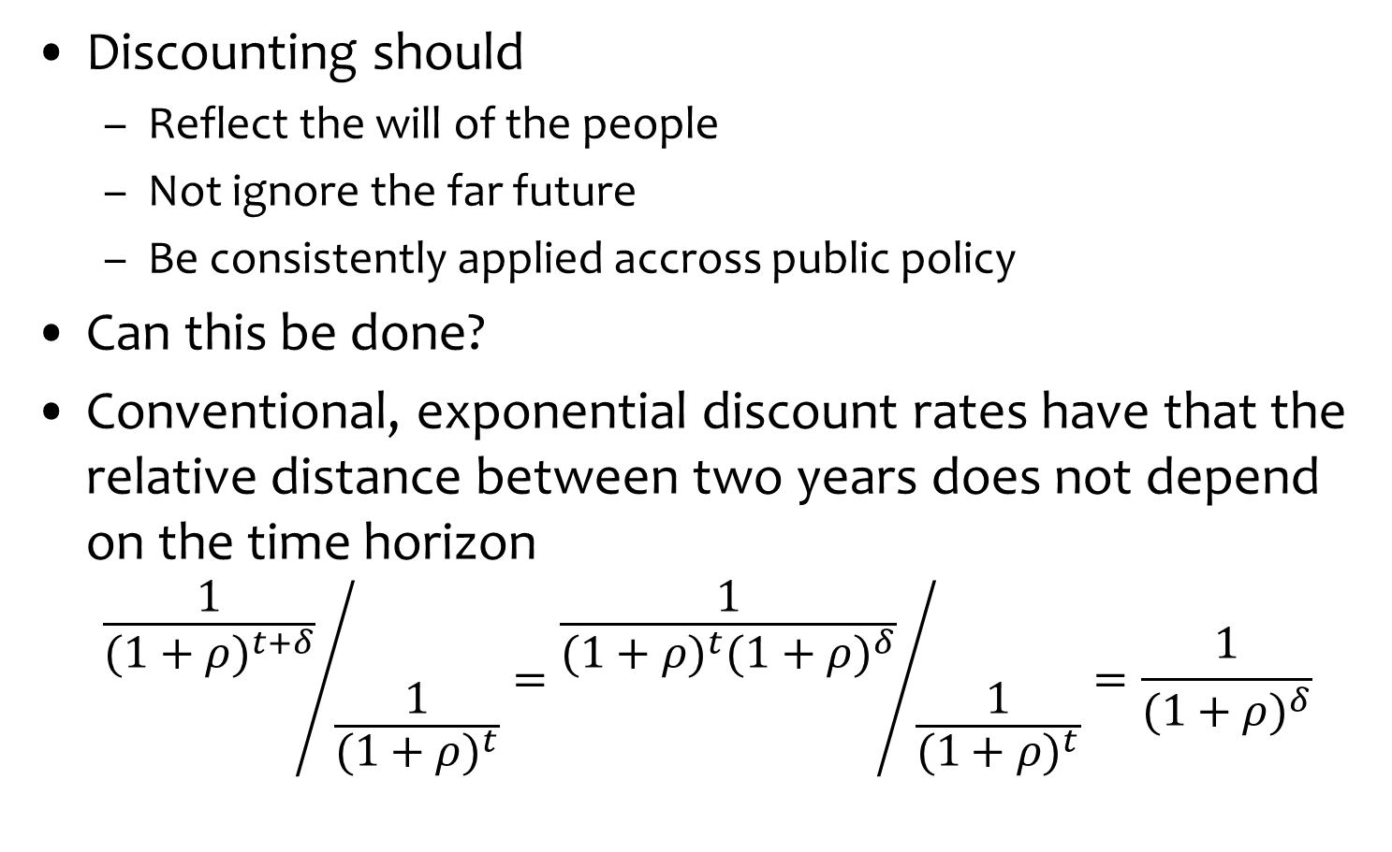
Declining discount rates
Discounting should
Reflect the will of the people
Not ignore the far future
Be consistently applied accross public policy
Can this be done?
Conventional, exponential discount rates have that the relative distance between two years does not depend on the time horizon
$${\frac{1}{{(1+ρ)}^{t+δ}}}/{\frac{1}{{(1+ρ)}^{t}}}={\frac{1}{{(1+ρ)}^{t}{(1+ρ)}^{δ}}}/{\frac{1}{{(1+ρ)}^{t}}}=\frac{1}{{(1+ρ)}^{δ}}$$

Slide 16

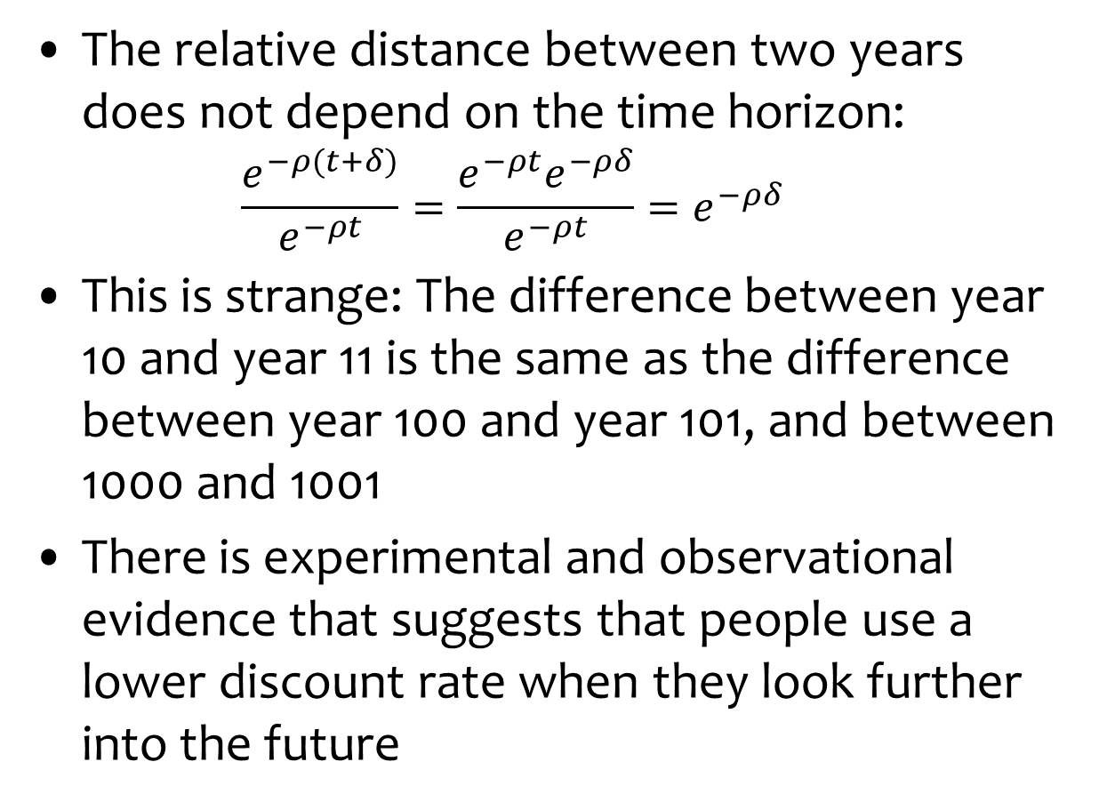
Hyperbolic Discount Rates
The relative distance between two years does not depend on the time horizon:
$$\frac{e^{−ρ(t+δ)}}{e^{−ρt}}=\frac{e^{−ρt}e^{−ρδ}}{e^{−ρt}}=e^{−ρδ}$$
This is strange: The difference between year 10 and year 11 is the same as the difference between year 100 and year 101, and between 1000 and 1001
There is experimental and observational evidence that suggests that people use a lower discount rate when they look further into the future

Slide 17
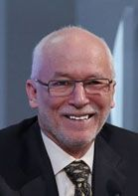
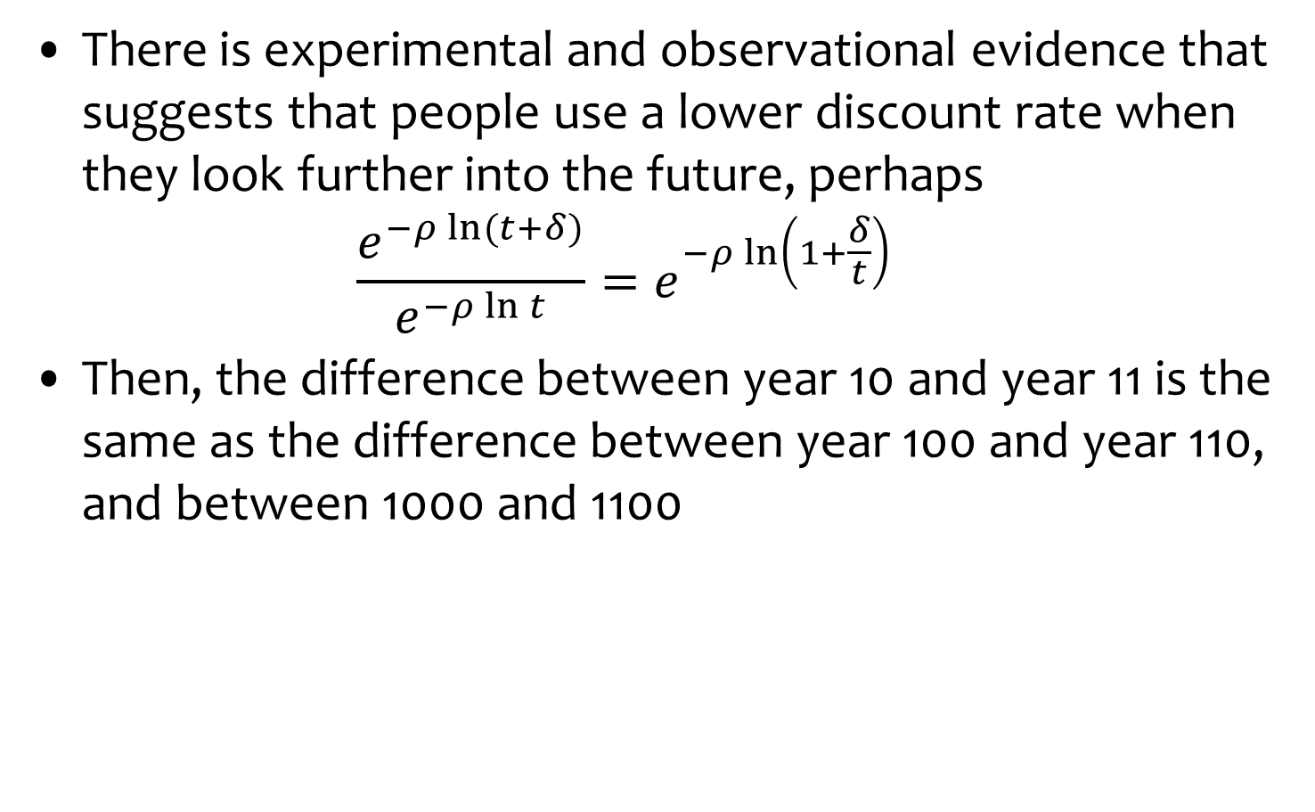
Hyperbolic Discount Rates -2
There is experimental and observational evidence that suggests that people use a lower discount rate when they look further into the future, perhaps
$$\frac{e^{−ρ\ln{(t+δ)}}}{e^{−ρ\ln{t}}}=e^{−ρ\ln\left(1+\frac{δ}{t}\right)}$$
Then, the difference between year 10 and year 11 is the same as the difference between year 100 and year 110, and between 1000 and 1100

Slide 18
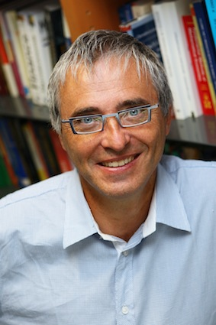
Declining Discount Rates
A similar effect (but not identical) can be achieved through disagreement

Slide 19
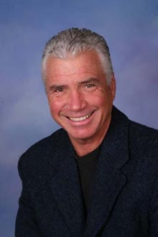
Declining Discount Rates
A similar effect (but not identical) can be achieved through uncertainty

Slide 20
Declining Discount Rates -2
If we assume that the discount rate is uncertain and follows a Gamma distribution, then the certainty-equivalent discount rate equals
r(t) = α / (1+βt)
where α is a location parameter and β a spread parameter
SCC ($/tC) | DDR | CDR
Green Book | 18 | 6.6
Gamma | 88 | 2.1
DDR: Declining discount rate
CDR: Constant discount rate, starting at the same rate as the DDR

Slide 21
Discounting, Equity, Risk
Time
Ramsey rule
Declining discount rates
Space
Equity weights
Risk
Expectations
Certainty equivalents
Dismal theorem
All together now
How to choose ethical parameters

Slide 22
Optimal emission reduction
Climate change is long-term, global, uncertain problem
If you do not care about the distant future, far-away lands, remote probabilities, you do not care about climate change

Slide 23
Differences in Values
Impacts of climate change differ greatly between countries

Slide 25
Differences in Values
Impacts of climate change differ greatly between countries
Initially, people just added the monetised climate change impacts
This caused a furore: Health risks reflect ability to pay, differ with income
Value of a statistical life is an empirical quantity
Internal consistency is important too
Instead, one can use different weights for different countries

Slide 26
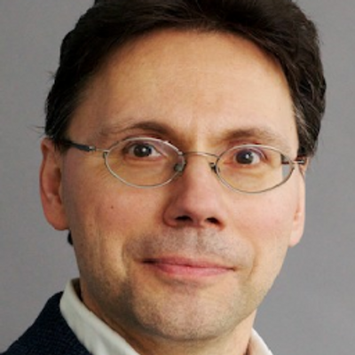
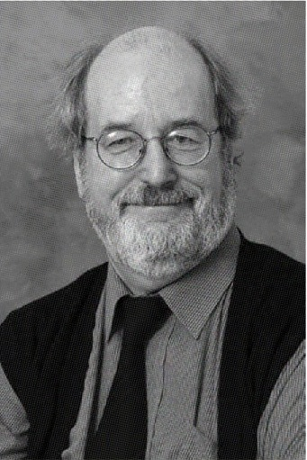
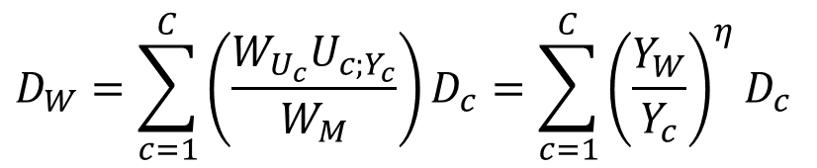
Equity Weights
Fankhauser, Pearce & Tol
Damage in money in country c is first transformed to damage in utility in country c
Then transformed to damage in global welfare
And finally transformed back to money
$$D_{W}=\sum_{c=1}^{C}{\left(\frac{W_{U_{c}}U_{c;Y_{c}}}{W_{M}}\right)D_{c}}=\sum_{c=1}^{C}{{\left(\frac{Y_{W}}{Y_{c}}\right)}^{η}D_{c}}$$

Slide 27

Equity Weights
Fankhauser et al:
National impacts valued at world average
$$D_{W}=\sum_{c=1}^{C}{\left(\frac{W_{U_{c}}U_{c;Y_{c}}}{W_{M}}\right)D_{c}}=\sum_{c=1}^{C}{{\left(\frac{Y_{W}}{Y_{c}}\right)}^{η}D_{c}}$$
$$D_{W}=\sum_{c=1}^{C}{{\left(\frac{Y_{W}}{Y_{c}}\right)}^{η}D_{c}}=\sum_{c=1}^{C}{{\left(\frac{Y_{W}}{Y_{c}}\right)}^{η}V_{c}I_{c}}= \\ \sum_{c=1}^{C}{{\left(\frac{Y_{W}}{Y_{c}}\right)}^{η}V_{W}{\left(\frac{Y_{c}}{Y_{W}}\right)}^{ε}I_{c}}\overset{ε=η}{=}\sum_{c=1}^{C}{V_{W}I_{c}}$$

Slide 28
No equity, no uncertainty
Equity, no uncertainty

Slide 30
Discounting, Equity, Risk
Time
Ramsey rule
Declining discount rates
Space
Equity weights
Risk
Expectations
Certainty equivalents
Dismal theorem
All together now
How to choose ethical parameters

Slide 31
Optimal emission reduction
Climate change is long-term, global, uncertain problem
If you do not care about the distant future, far-away lands, remote probabilities, you do not care about climate change

Slide 32
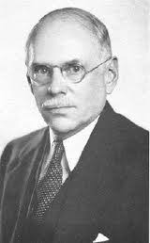
Risk v Uncertainty
Risk = uncertain but with known probabilities
Uncertainty = uncertain with unknown probabilities

Slide 35
Discounting, Equity, Risk
Time
Ramsey rule
Declining discount rates
Space
Equity weights
Risk
Expectations
Certainty equivalents
Dismal theorem
All together now
How to choose ethical parameters

Slide 36
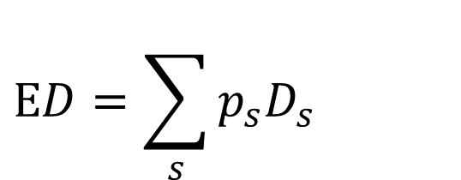

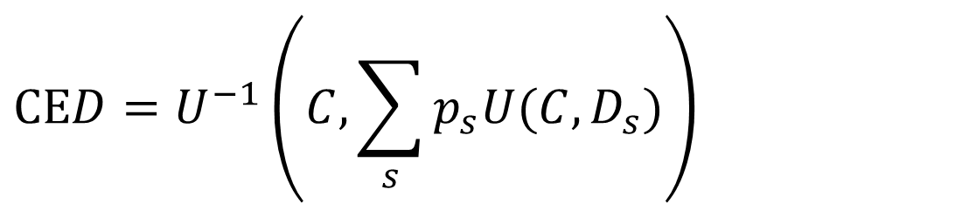
Risk
Expected damage
Certainty equivalent damage
Risk premium
$$ED=\sum_{s}{p_{s}D_{s}}$$
$$\text{CE}D=U^{−1}\left(C,\sum_{s}{p_{s}U(C,D_{s})}\right)$$
$$RP\text{=}\text{CE}D\text{−}\text{E}D$$

Slide 39
No equity, no uncertainty
No equity, uncertainty

Slide 41
Discounting, Equity, Risk
Time
Ramsey rule
Declining discount rates
Space
Equity weights
Risk
Expectations
Certainty equivalents
Dismal theorem
All together now
How to choose ethical parameters

Slide 42
Dismal Theorem
Weitzman (2009): the uncertainty about climate change may be too large for expected utility maximisation
Derivation via convolutions and moment generating functions

Slide 43
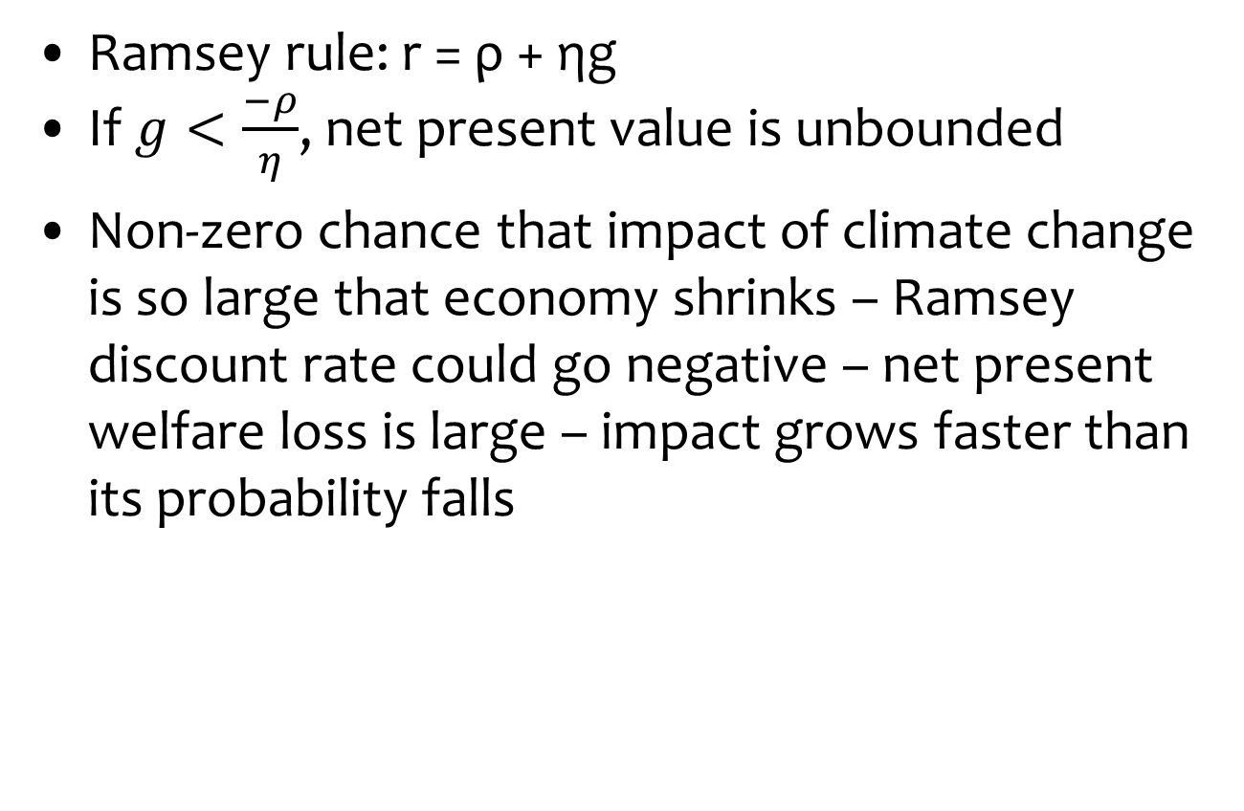
Dismal Theorem
Ramsey rule: r = ρ + ηg
If $g<\frac{−ρ}{η}$, net present value is unbounded
Non-zero chance that impact of climate change is so large that economy shrinks – Ramsey discount rate could go negative – net present welfare loss is large – impact grows faster than its probability falls

Slide 44
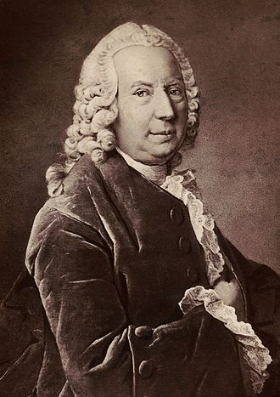
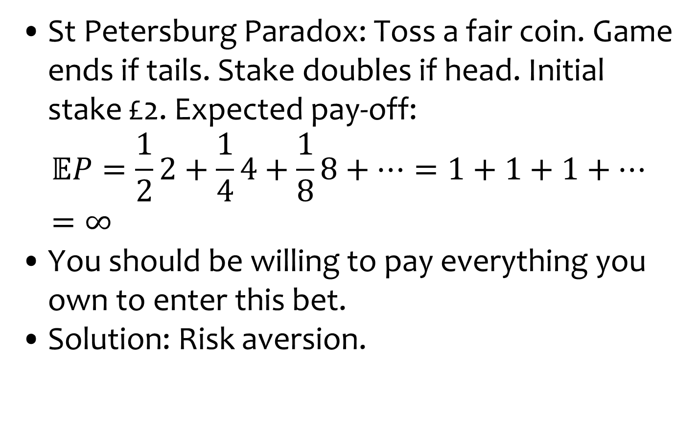
Dismal Theorem
St Petersburg Paradox: Toss a fair coin. Game ends if tails. Stake doubles if head. Initial stake £2. Expected pay-off:
$$𝔼P=\frac{1}{2}2+\frac{1}{4}4+\frac{1}{8}8+…=1+1+1+…=∞$$
You should be willing to pay everything you own to enter this bet.
Solution: Risk aversion.

Slide 45
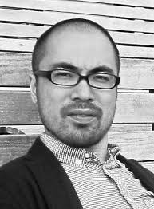
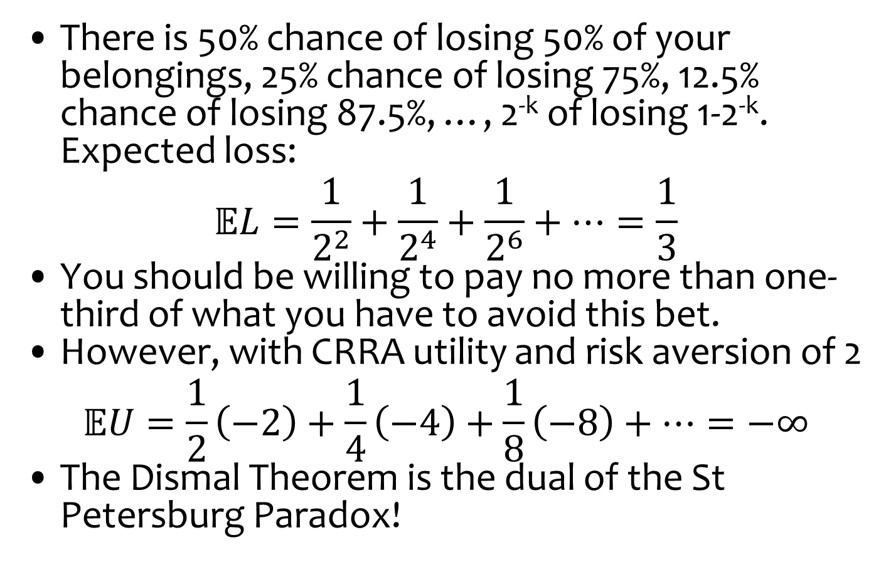
Dismal Theorem
There is 50% chance of losing 50% of your belongings, 25% chance of losing 75%, 12.5% chance of losing 87.5%, …, 2^{-k} of losing 1-2^{-k}. Expected loss:
$$𝔼L=\frac{1}{2^{2}}+\frac{1}{2^{4}}+\frac{1}{2^{6}}+…=\frac{1}{3}$$
You should be willing to pay no more than one-third of what you have to avoid this bet.
However, with CRRA utility and risk aversion of 2
$$𝔼U=\frac{1}{2}\left(−2\right)+\frac{1}{4}\left(−4\right)+\frac{1}{8}\left(−8\right)+…=−∞$$
The Dismal Theorem is the dual of the St Petersburg Paradox!

Slide 46
Dismal Theorem
Regardless of the derivation, the Dismal Theorem says that
Expected net present welfare is unbounded
The Pigou tax is arbitrarily large

Slide 47
Policy Implications
Some see the Dismal Theorem as a formalisation of the Precautionary Principle, others as a justification of stringent climate policy
That’s not true: The Dismal Theorem only says that you cannot use cost-benefit analysis in certain circumstances
Weitzman does not indicate what to do instead
Fossil fuels are an essential input in the short run, so an arbitrarily large carbon tax would do a lot of harm

Slide 48
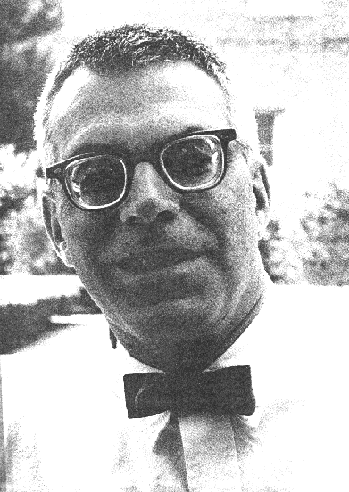
Minipercentile Regret
Minimax regret is a standard decision criterion in case of large uncertainty
For every state of the world, find the optimum tax
For every tax in each state of the world, calculate the welfare difference from the optimum
Across states of the world, find the tax that minimises regret
As continuous probability, we here use percentiles rather than the maximum

Slide 50
Implications
There is dangerous climate change
There is dangerous climate policy too

Slide 51
Discounting, Equity, Uncertainty
Time
Ramsey rule
Declining discount rates
Space
Equity weights
Risk
Expectations
Certainty equivalents
Dismal theorem
All together now
How to choose ethical parameters

Slide 52
No equity, no uncertainty
Equity, no uncertainty
No equity, uncertainty
Equity, uncertainty

Slide 53
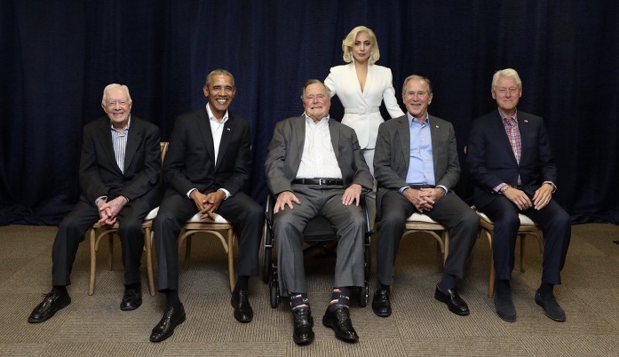
What values
The rates of pure time preference, inequity aversion, and risk aversion describe how much we care about the future, others, uncertainties
Two approaches to such ethical parameters
Philosophy, religion
What would Aristotle, Jesus, Lao Tzu, Mohammed, Johnny Rotten, Lord Stern, Lady Gaga do?
Revealed preferences
What does the average person do?
Consistency is crucial (cf. Schelling)
If you don’t care about Africa in your trade policy, why do you care about Africa in your environmental policy?

